Slide 1
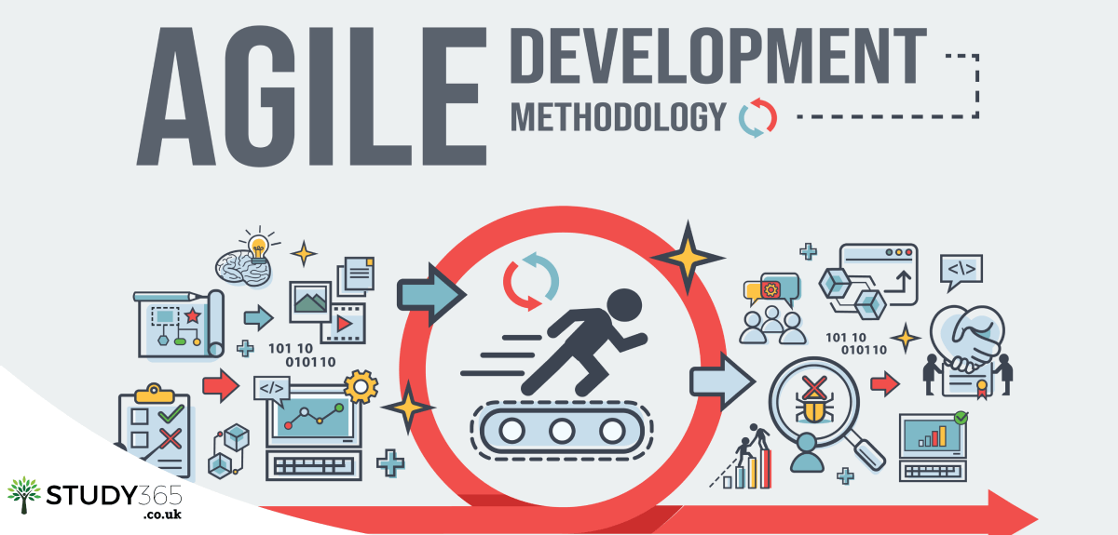

Slide 2
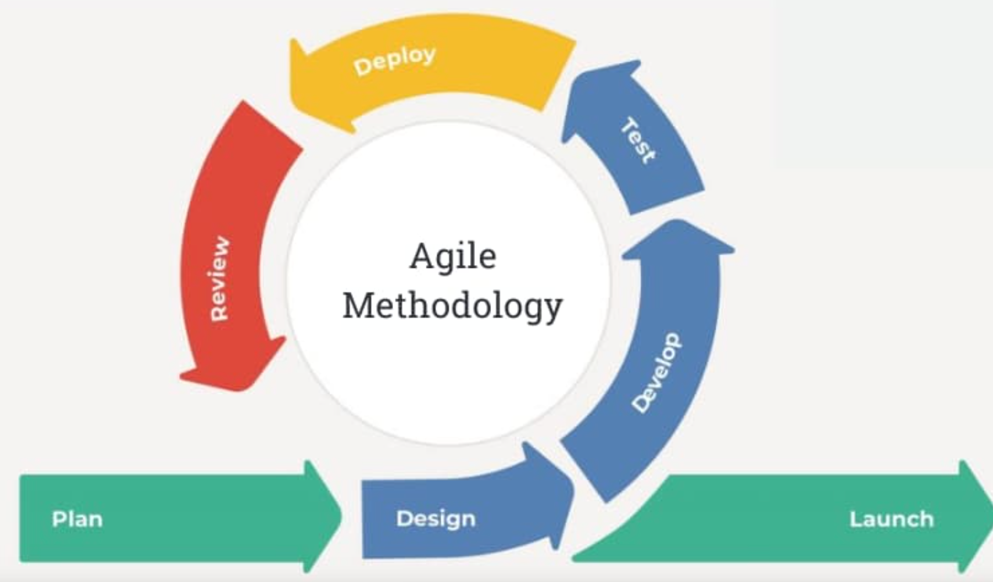
Agile Methodology

Slide 3
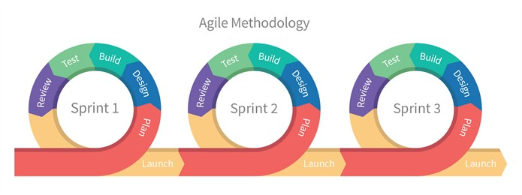
Agile

Slide 4
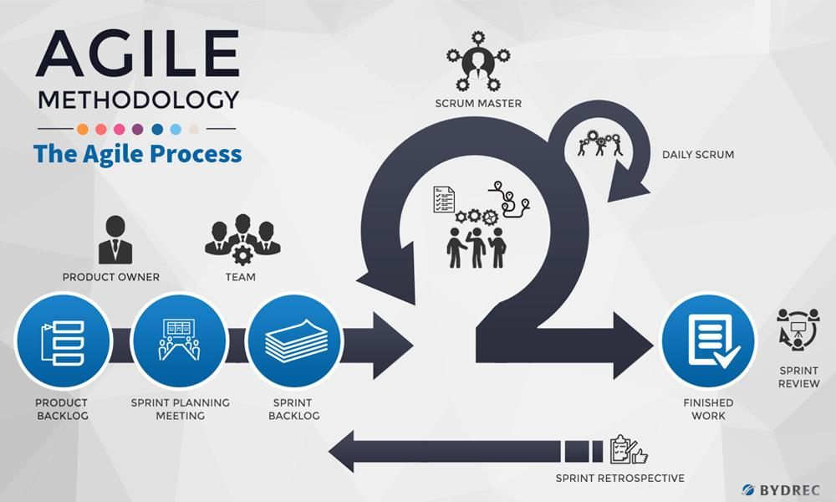

Slide 5
In Scrum, the daily standup meeting (also known as the daily scrum) is a key practice that helps the development team synchronize their work, identify obstacles, and plan their activities for the upcoming day. Here are some best practices for conducting effective standup meetings in Scrum:
Time and Place: The standup should be held at the same time and place every day to establish a routine. This helps team members plan their schedules accordingly.
15-Minute Timebox: The standup should be timeboxed to 15 minutes or less. This ensures that the meeting remains focused and efficient, encouraging concise updates.
Three Questions: Each team member answers the following three questions:
What did I accomplish since the last standup?
What will I work on today?
Are there any obstacles or impediments blocking my progress?
Focus on the Sprint Goal: Discussions should center around how each team member's work contributes to achieving the sprint goal. This reinforces alignment with the overall project objectives.
No Detailed Problem Solving: The standup is not meant for in-depth problem-solving discussions. If an obstacle requires more discussion, it's better to have separate conversations after the standup.
Scrum Master's Role: The Scrum Master facilitates the standup by ensuring it stays within the timebox, coaching the team to follow the three questions format, and helping to remove any obstacles raised.
Team Collaboration: The standup is an opportunity for team members to share information, collaborate, and offer help to each other. If someone finishes their tasks early, they can assist others.
Visual Aids: Some teams use visual aids like a task board or a digital tool to track progress. This provides a clear visualization of work items and their status.
Standing Up: While not mandatory, the practice of standing during the standup can encourage brevity and keep the meeting focused.
Consistency: Consistency in the standup format and timing is crucial. This helps the team develop a rhythm and makes it easier to identify patterns and improvements over time.
Avoid Status Reporting to Managers: The standup is primarily for the development team. Managers or stakeholders may attend as observers, but the focus should be on the team's collaboration and progress.
Remote Teams: If the team is distributed, use video conferencing tools for virtual standups. The same rules apply for timeboxing and focusing on the three questions.
Daily, Not Always In-Person: The term "standup" doesn't mean you have to stand physically. It's more about keeping the meeting brief and to the point. In some cases, teams may even hold virtual standups while seated.
Remember, the standup is a tool for the development team to self-organize, communicate, and adapt their plans. It's meant to foster collaboration and transparency, helping the team to continuously improve and deliver value in each sprint.

Slide 6
User Story
A user story is a tool used in Agile software development to capture a description of a software feature from an end-user perspective. The user story describes the type of user, what they want and why. A user story helps to create a simplified description of a requirement.
A user story template often uses the following type of format:
<role>, I want <feature> so that <reason>
Examples of user stories are:
As a user, I want to upload photos so that I can share photos with others.

Slide 7
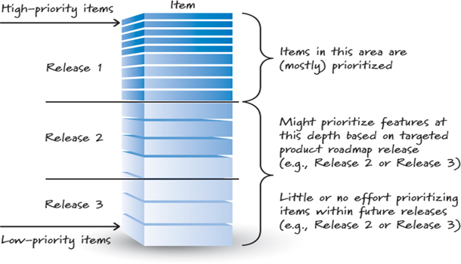

Slide 8
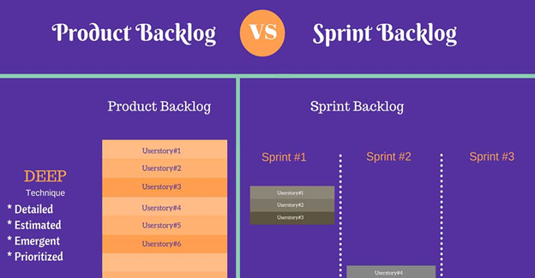

Slide 9
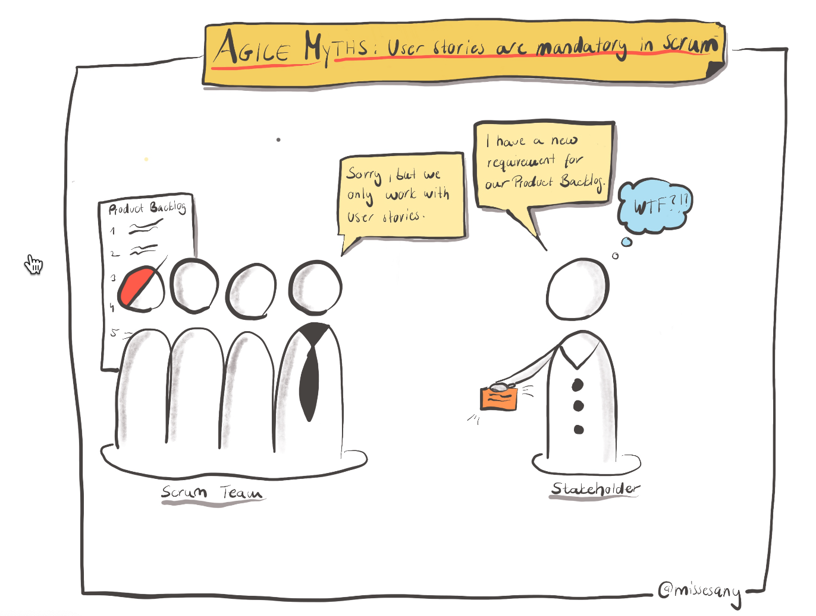

Slide 10
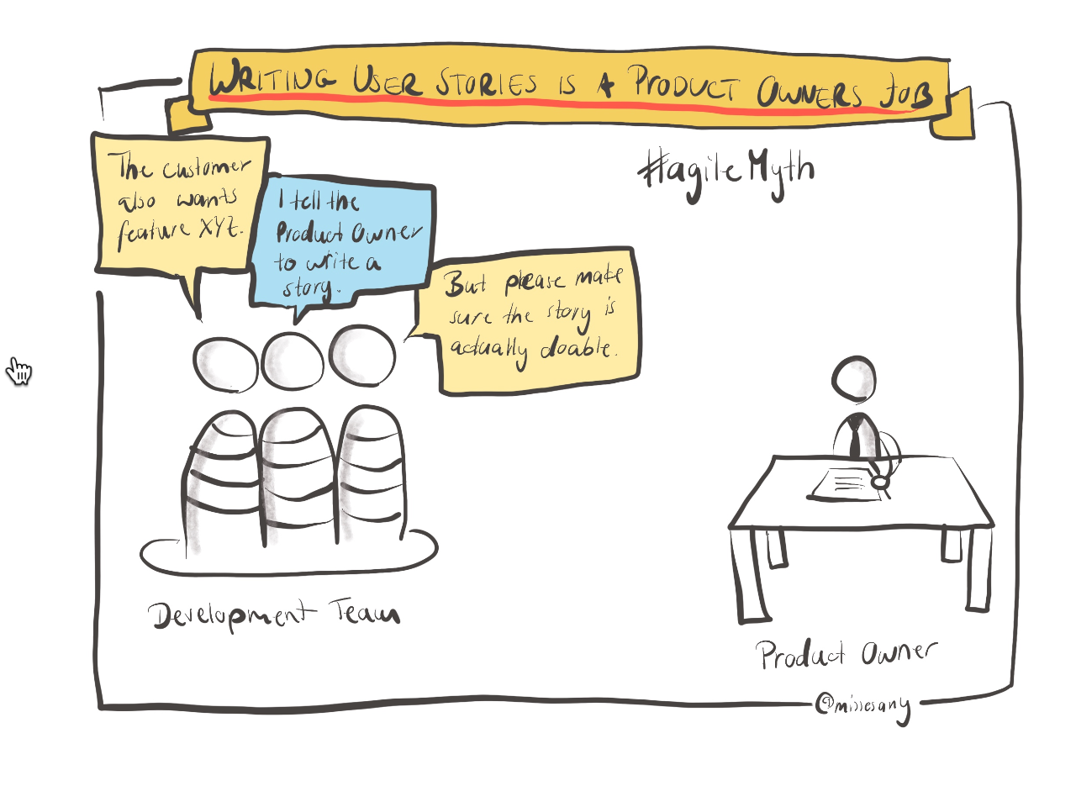

Slide 11
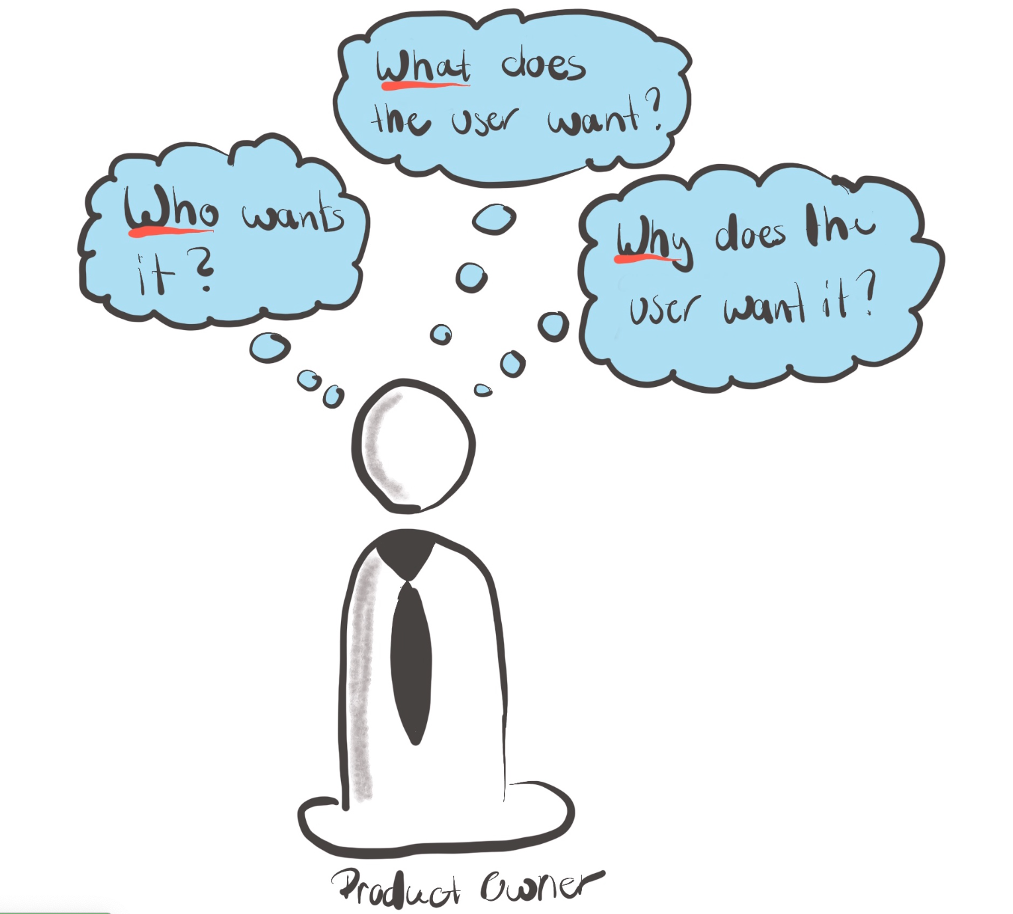

Slide 12
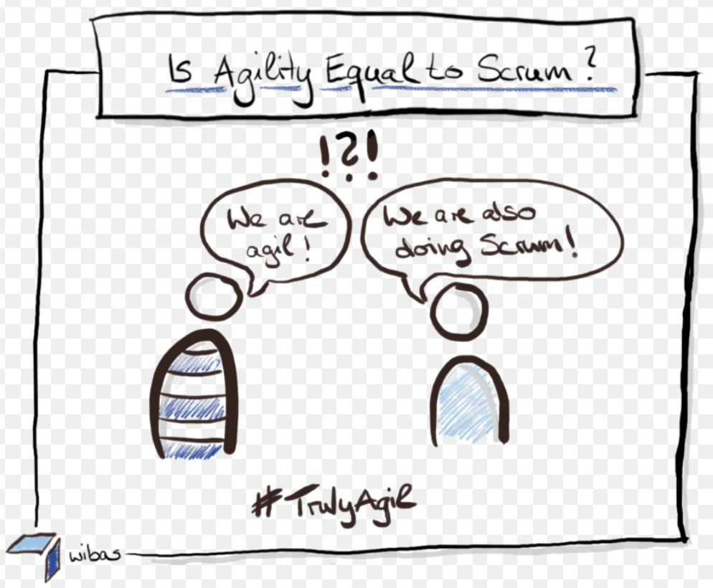

Slide 13
Waterfall | Agile
Software development process is divided into distinct phases. | It separates the project development lifecycle into sprints.
Waterfall is a structured software development methodology, and often times can be quite rigid, | whereas the Agile methodology is known for its flexibility.
If you want to use the Waterfall model for software development, then you have to be clear with all the development requirements beforehand as there is no scope of changing the requirements once the project development starts | On the other hand, The Agile methodology is quite flexible, and allows for changes to be made in the project development requirements even after the initial planning has been completed.
All the project development phases such as designing, development, testing, etc. are completed once in the Waterfall model. | Agile methodology, they follow an iterative development approach. As a result, planning, development, prototyping and other software development phases can appear more than once during the entire SDLC.

Slide 14
Waterfall | Agile
The Waterfall model is best suited for projects which have clearly defined requirements and in which change is not expected at all | Agile is the best approach to follow when the requirements are expected to change and evolve.
Not suitable for Large project | Not suitable for small project

Slide 15
Advantage of Agile
It is client focused process. So, it makes sure that the client is continuously involved during every stage.
Agile teams are extremely motivated and self-organized so it likely to provide a better result from the development projects.
Agile software development method assures that quality of the development is maintained
The process is completely based on the incremental progress. Therefore, the client and team know exactly what is complete and what is not. This reduces risk in the development process.

